Slide 1
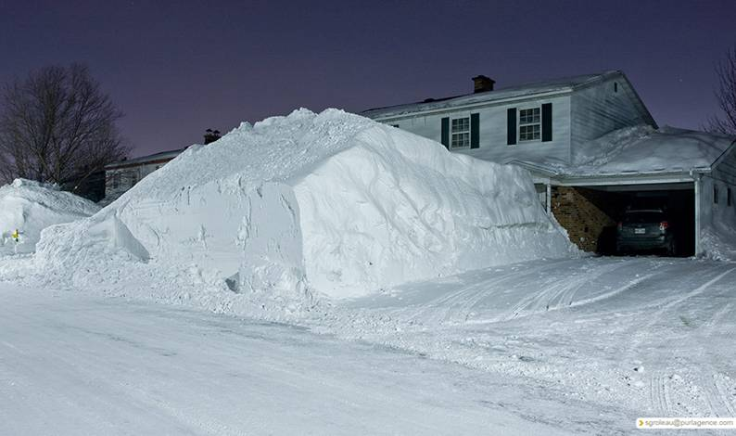






CoCoRaHS and Winter Weather Precipitation Muskegon Winter Skywarn
George Wetzel, Observation Program Leader
Cocorahs Regional Coord…NWS Grand Rapids

Slide 2

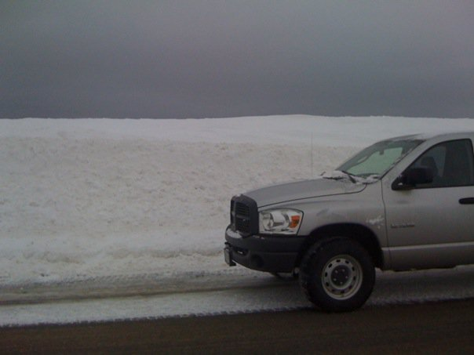
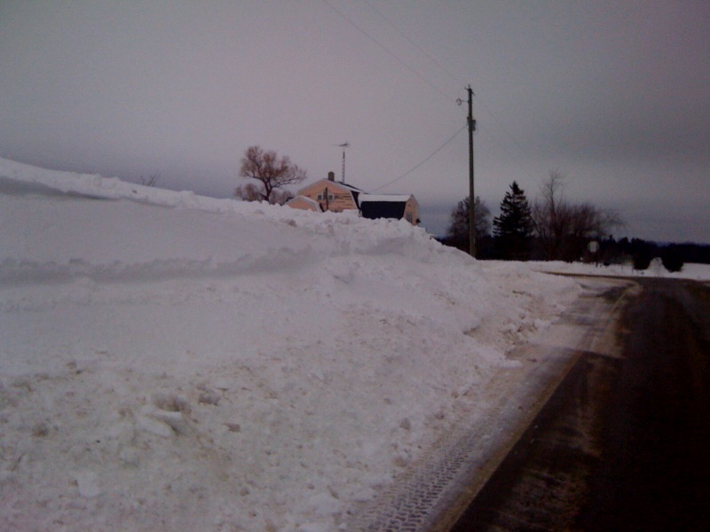
3 Miles NW of Montague in Muskegon County

Slide 3
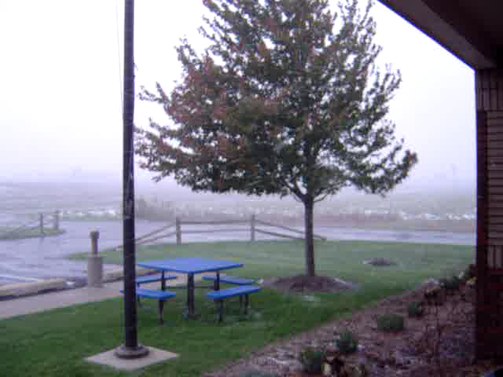

Slide 4
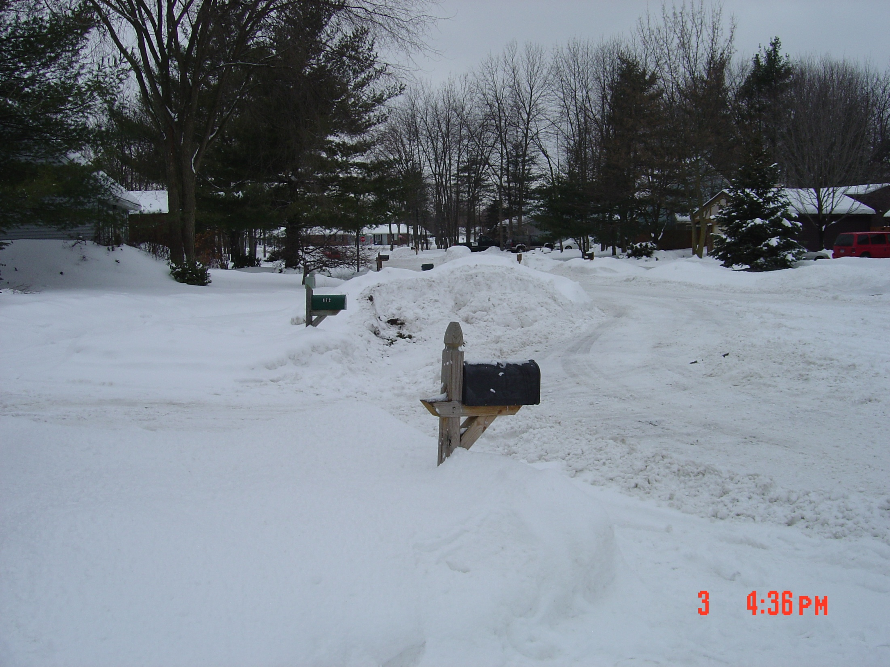
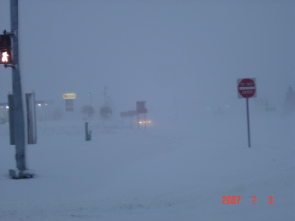
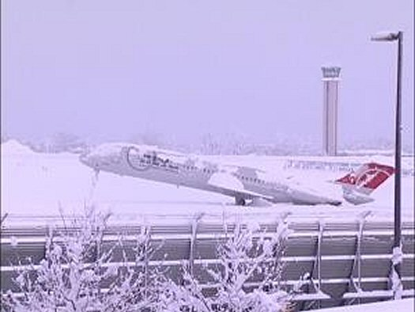
Your Observations and Reports Count

Slide 5
We’ll cover…
Types of Weather Observing Sites
River Gages
Finding Data on the web
Climate Centers
Cocorahs
  What is it?
  How to join
  How to measure snow and ice

Slide 6
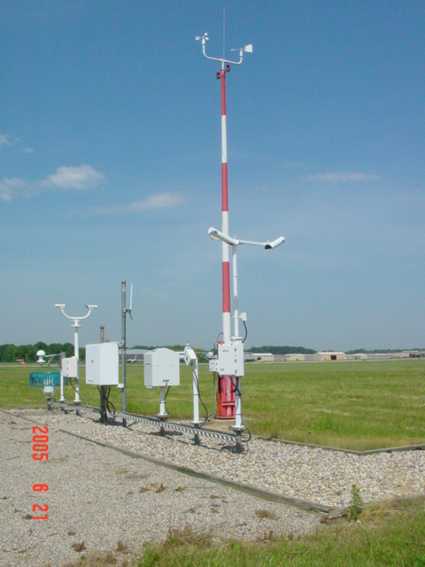
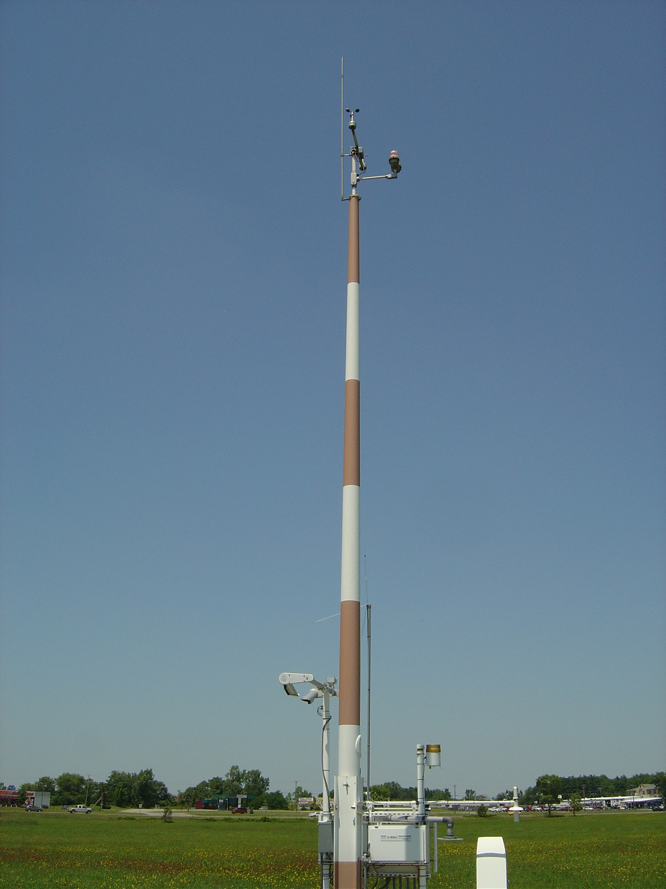
ASOS/AWOS Airport Stations
Kalamazoo ASOS
Charlotte AWOS

Slide 7
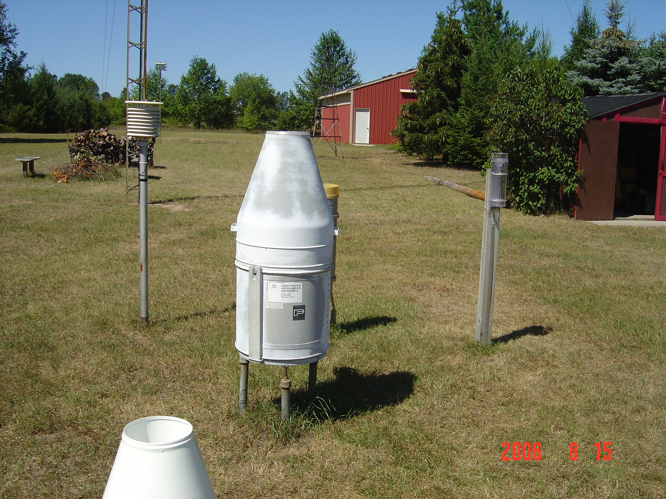
COOP Sites
24 hour hi/low
24hour rain/snow
Hourly Rainfall

Slide 8
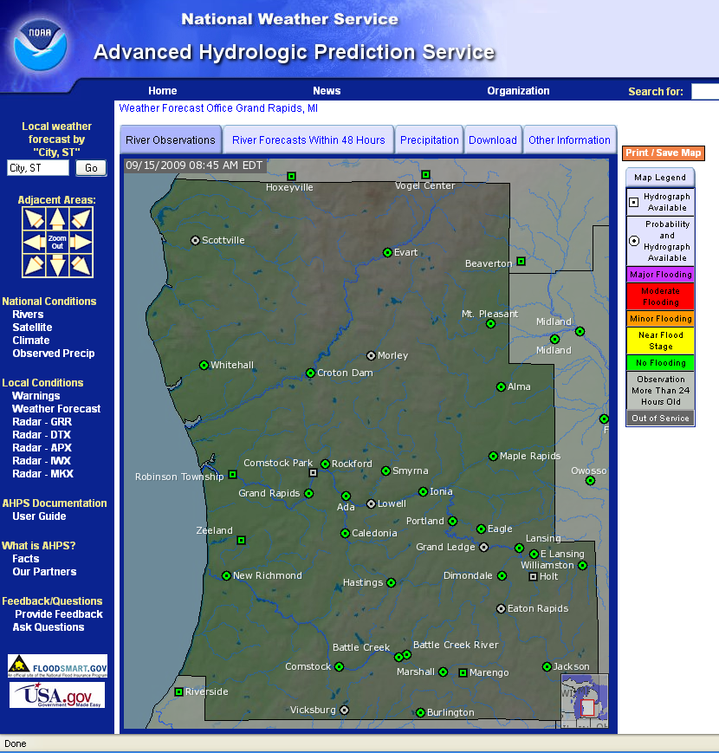
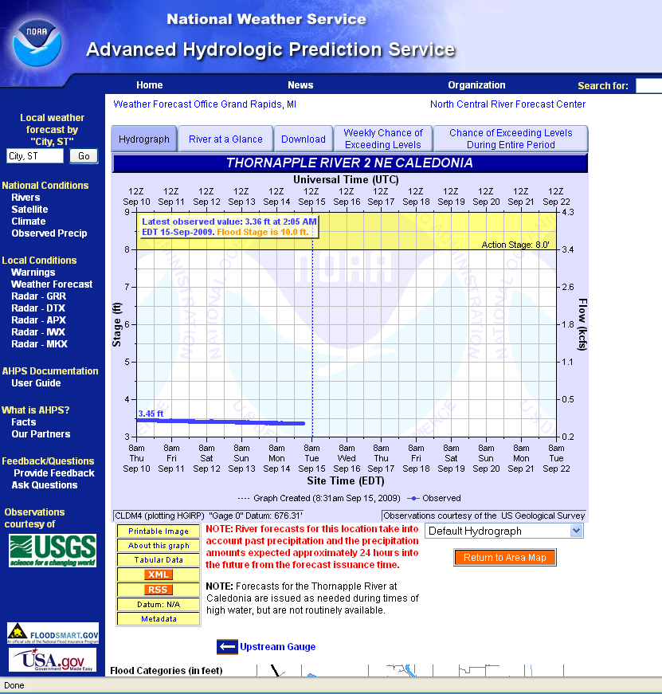
River Gages

Slide 9
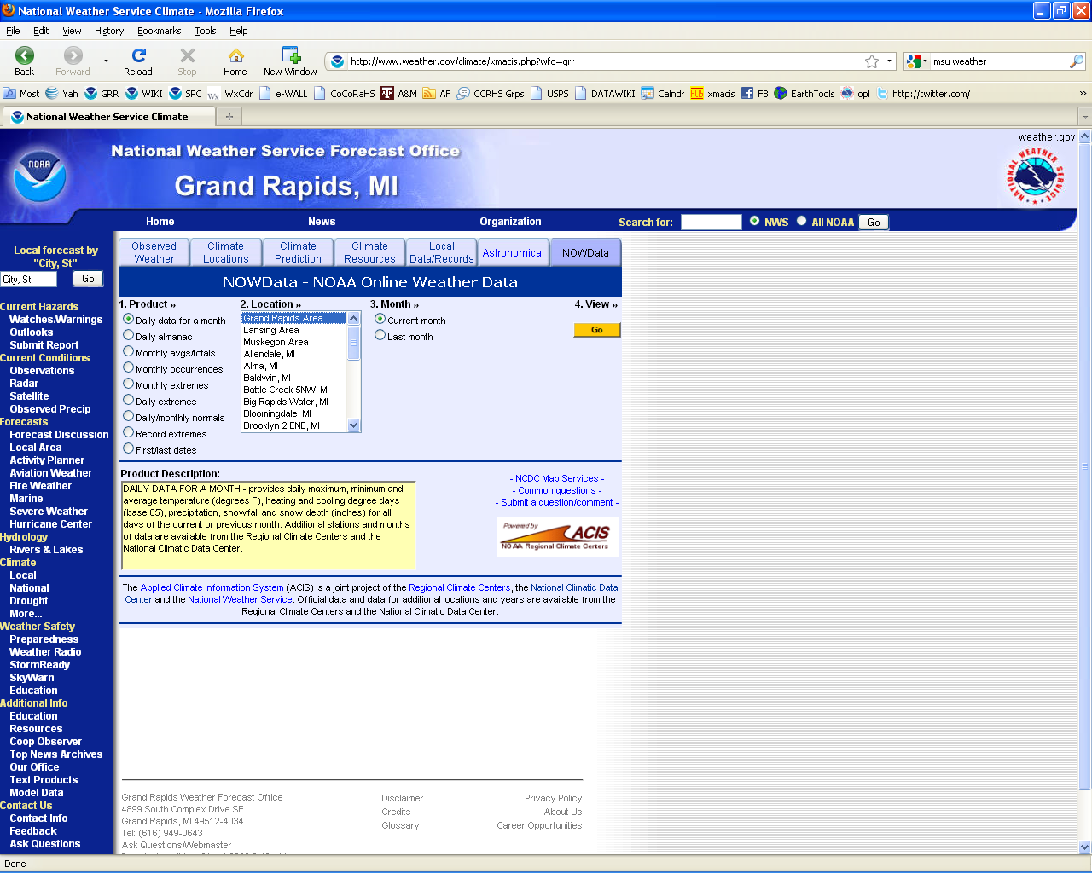
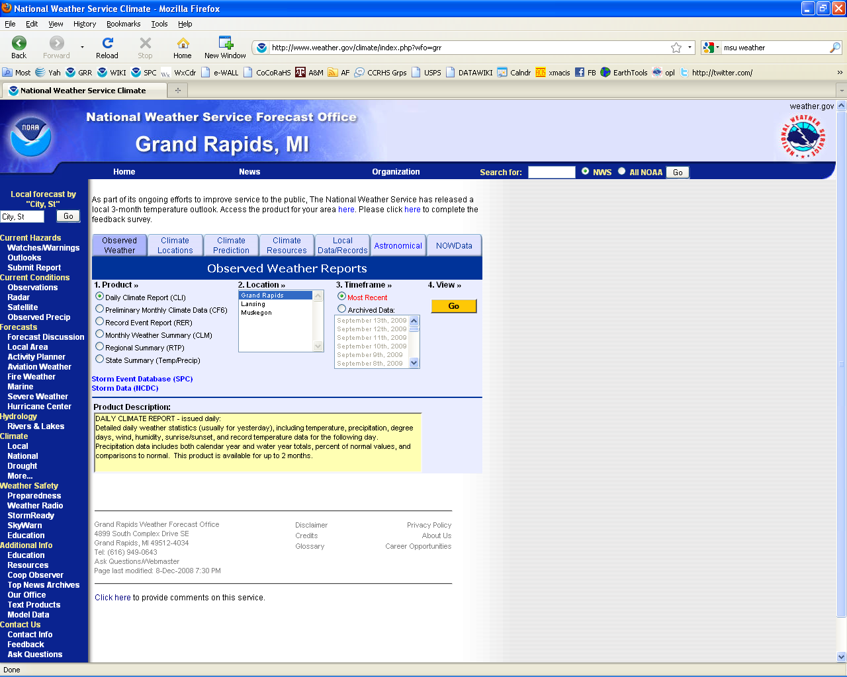
Finding the Data
NWS Grand Rapids website
has links to all types of data
ranging from hourly to same
day, to records and averages.

Slide 10
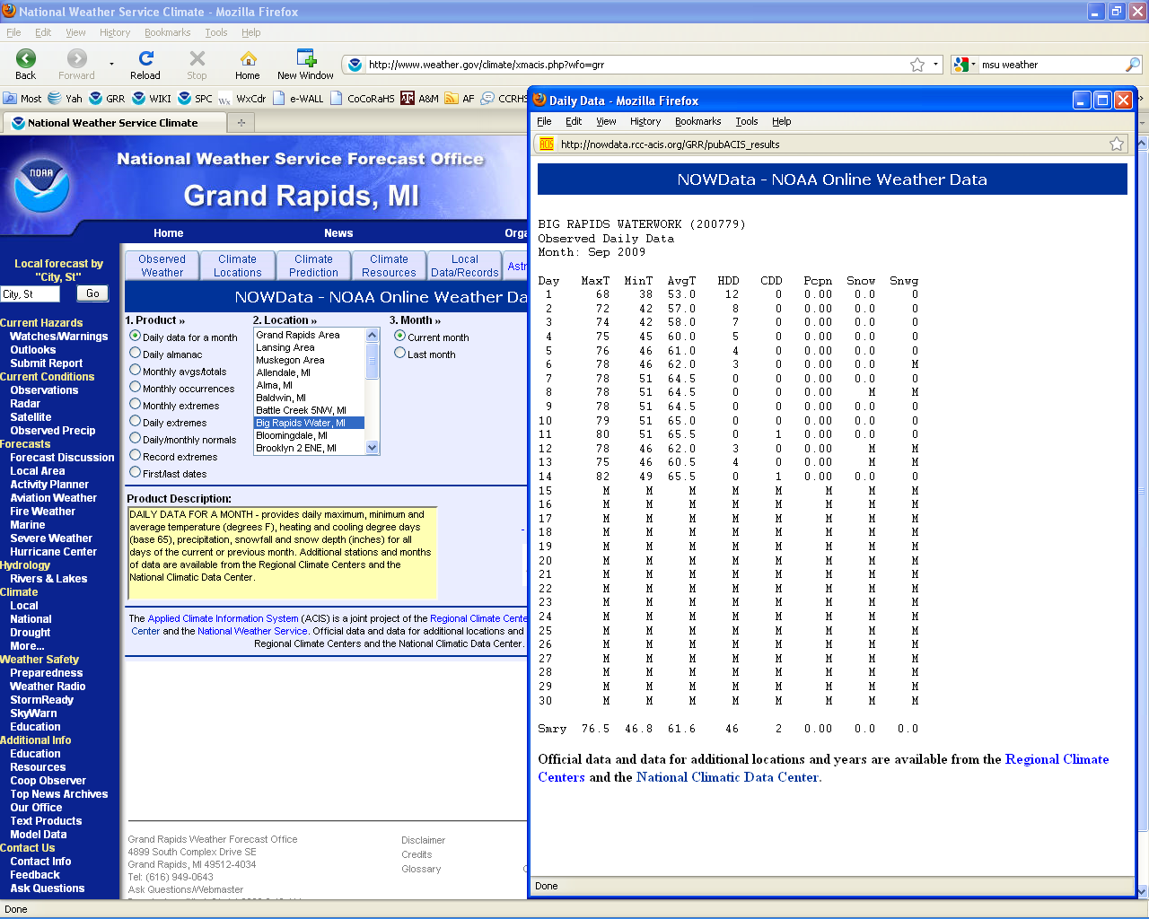
Results open up in a separate window.

Slide 11
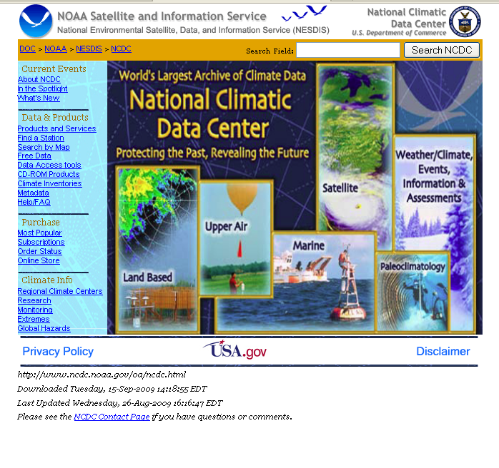
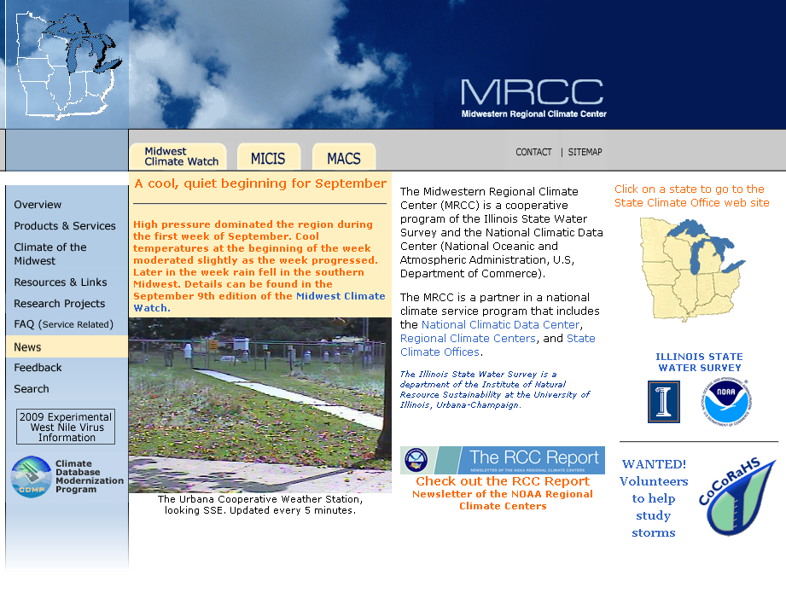
Data Collection Centers

Slide 12
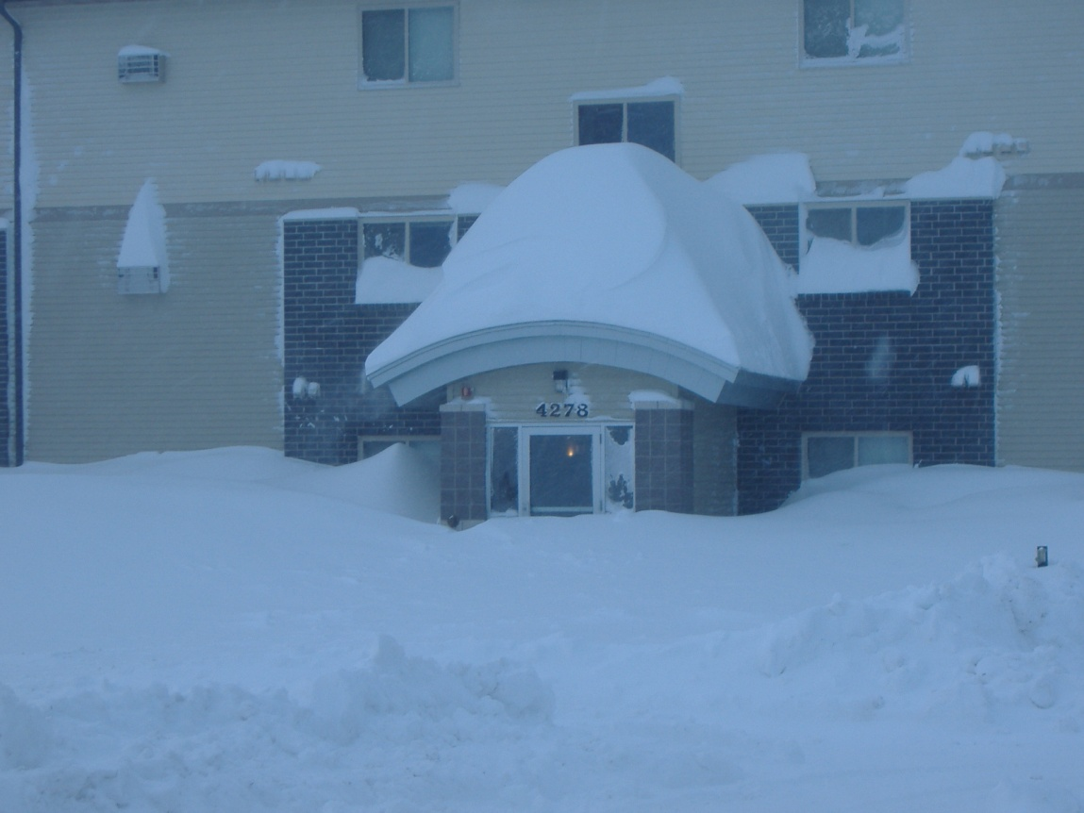
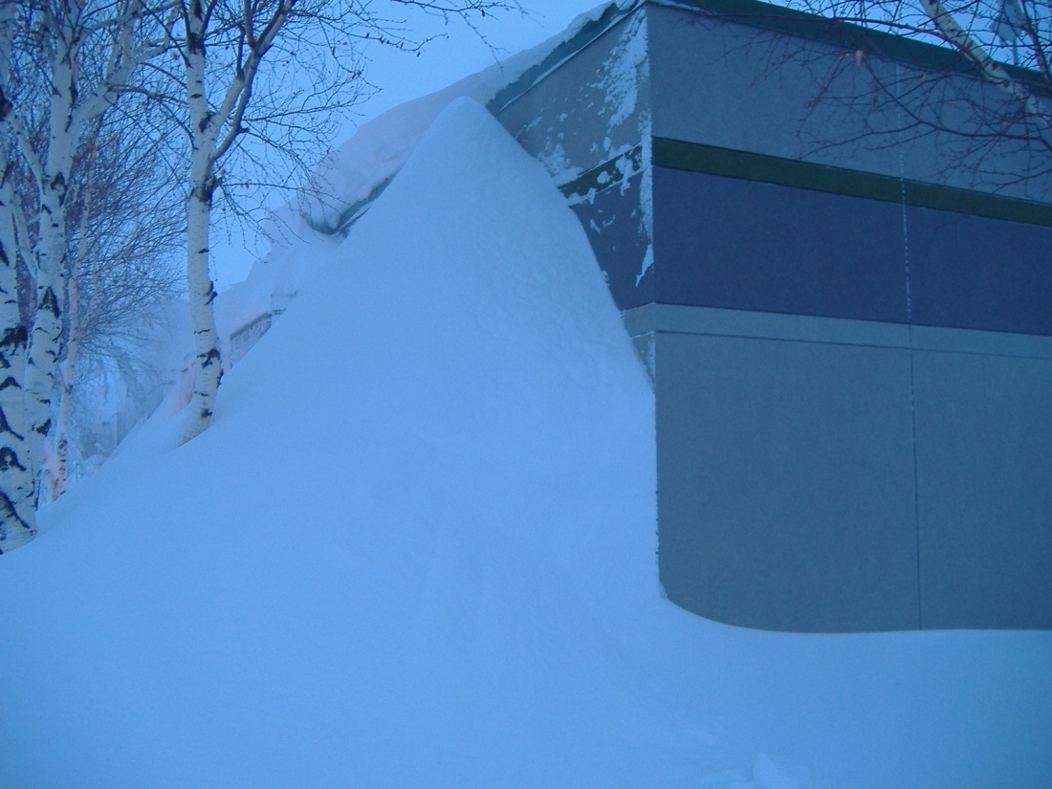
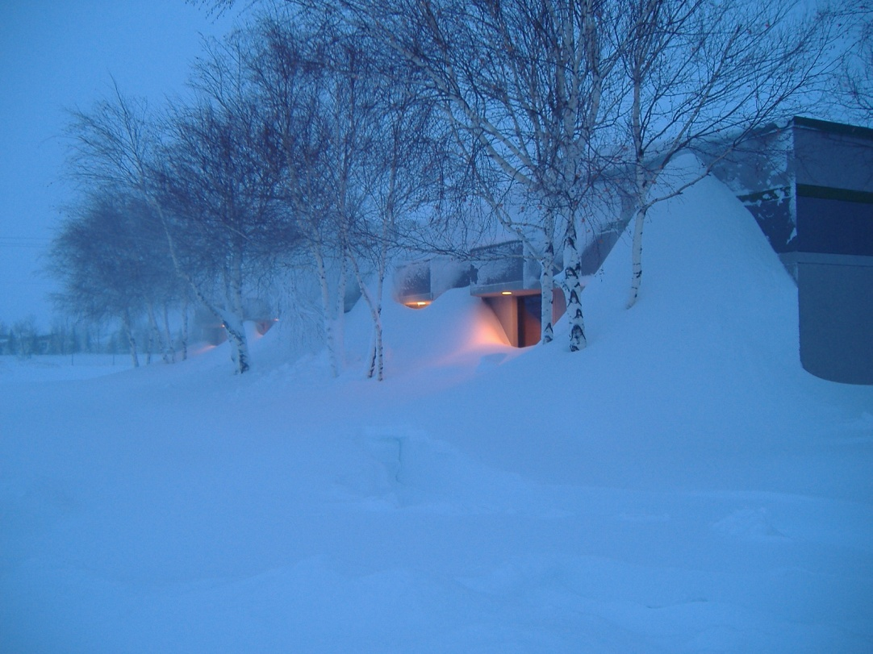
Think we have it bad?

Slide 13
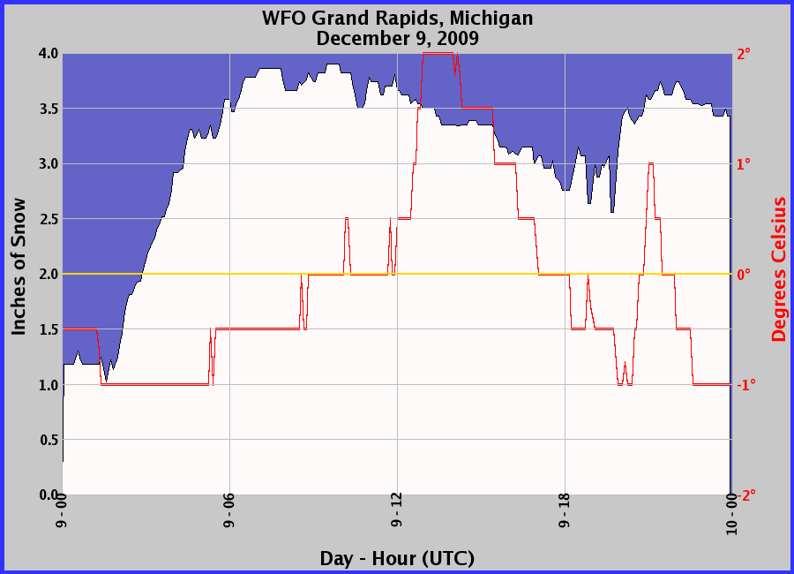
NWS GRR Snow Sensor
http://www.weather.gov/grr/snowsensor/

Slide 14

3 Easy Ways to Report
Phone: 1-800-MI-SEVEN (1-800-647-3836)
- Real time weather reports anytime (24X7)
NWS Grand Rapids Page: http://www.weather.gov/grr/spotter
- Report any weather event as it happens (24X7)
CoCoRaHS: http://www.cocorahs.org
You can report special observations on cocorahs involving
excessive snowfall or rainfall.
- Use 800# to phone in significant events as well.
All the reporting methods above reach the operations area in our office for quick dissemination to the public and media.
COCORAHS? What is it you ask?

Slide 15
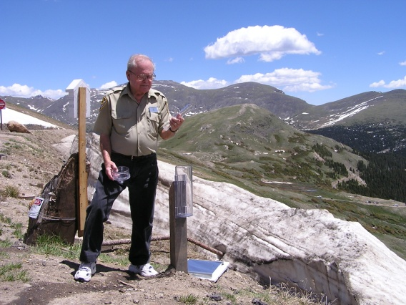
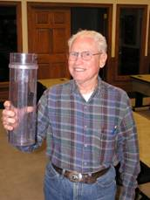
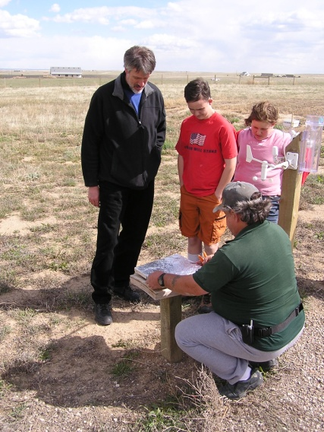
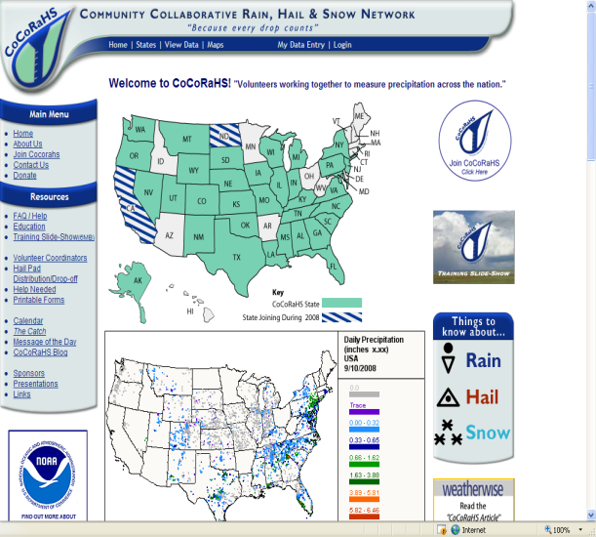
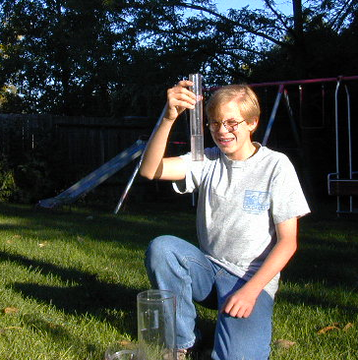
What is CoCoRaHS?
Unique, non-profit community-based observing network
Comprised entirely of volunteers approaching 20,000
Volunteers range in age from 7 years old to 80+
Community
Collaborative
Rain
and
Hail (and Snow)
Study

Slide 16
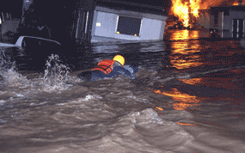
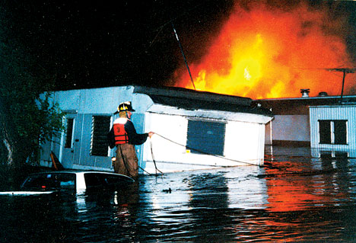
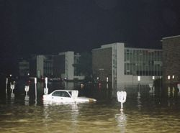
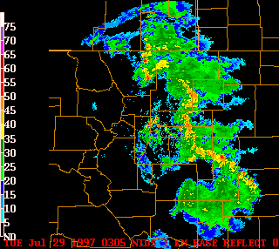
Origin of CoCoRaHS
Developed after deadly Fort Collins, CO flash flood event on July 28, 1997
Only 1 to 2 inches of rain fell at the “official” observing sites, but 9-12 inches fell in the foothills
$200 million in damages and 5 fatalities because “nobody knew it rained up in the mountains”
CoCoRaHS formed a year
later to “fill in the gaps”

Slide 17
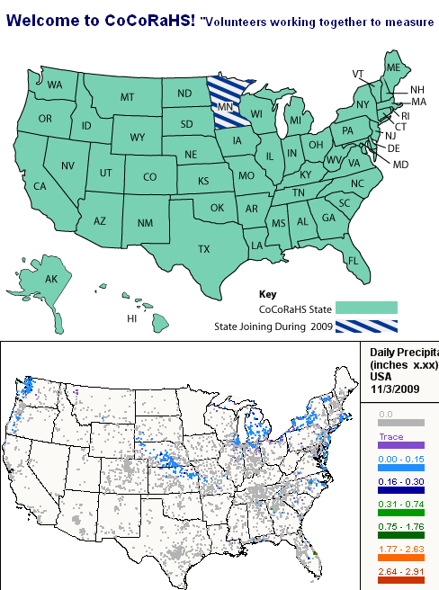
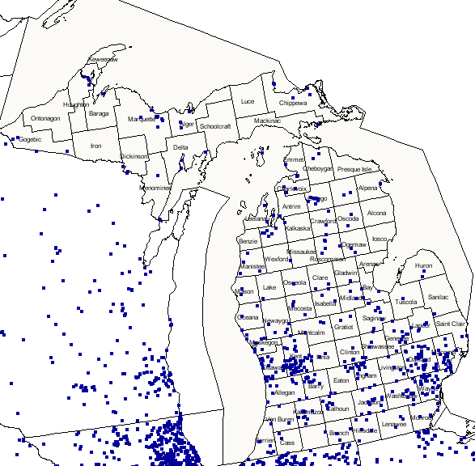
CoCoRaHS is Nationwide!
Over 20,000 trained U.S. observers and growing rapidly
Goal of all 50 states has been reached.
Notes:
CoCoRaHS is quickly expanding across the United States. The popularity seems to be fueled by the fact that families, schools, organizations, or individuals can sign up and participate. Thousands of people across the U.S. have some type of home weather instruments they monitor for personal use. CoCoRaHS can add a new dimension to those instruments and allow people to record and archive their precipitation data for local and immediate use, or for research and long term use. Indiana is one of the fastest growing CoCoRaHS networks in the country and is expected to be one of the highest density networks.

Slide 18
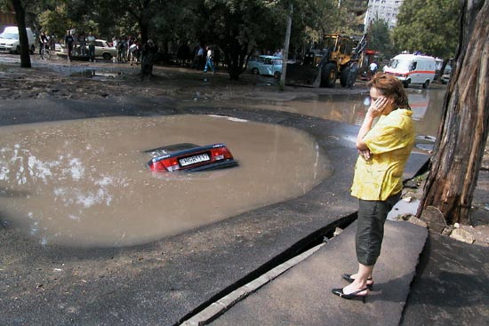
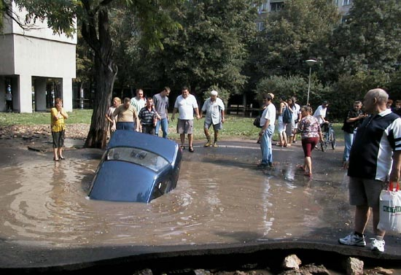
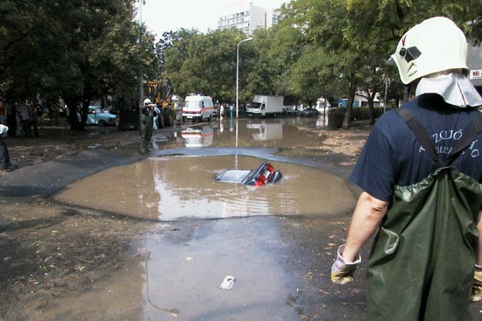
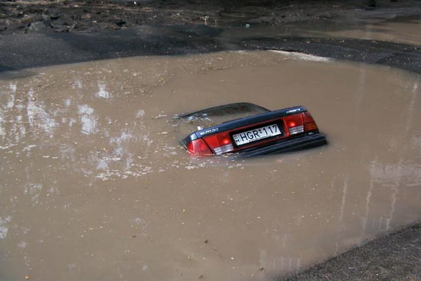
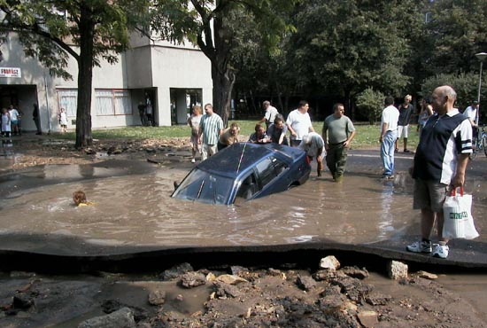
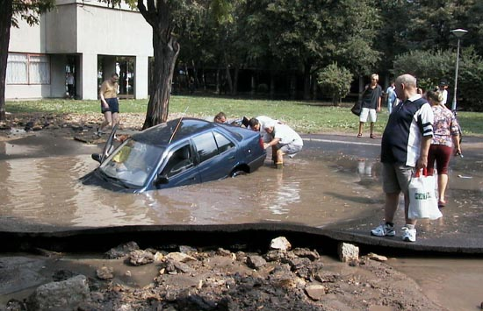
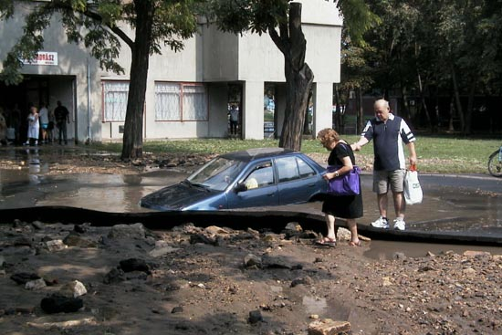
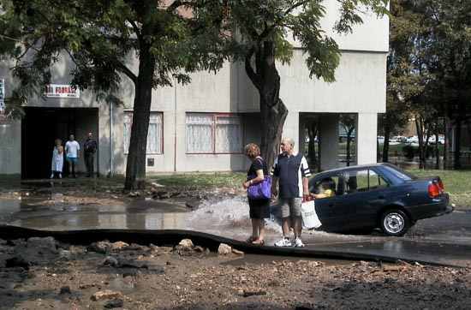
Why CoCoRaHS?
1) Precipitation is
important and highly variable
2) Data sources are few and rain gauges are far apart
3) Measurements are not always accurate (especially snow)
4) Floods and Drought are a part of a “normal” climate cycle
5) Storm reports can and do save lives!
Notes:
Why do we need CoCoRaHS data? This series of pictures illustrates the need for actual observations. A first look at the standing water suggest it is just a puddle. This is comparable to using precipitation estimates from the WSR-88D. The car represents actual observations, helping confirm or negate estimates. In this case, the observation does not support the initial estimate. The water is obviously more than just a puddle, with more significant impacts than initially anticipated.

Slide 19
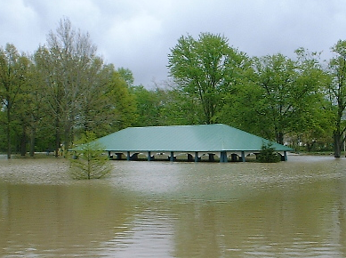
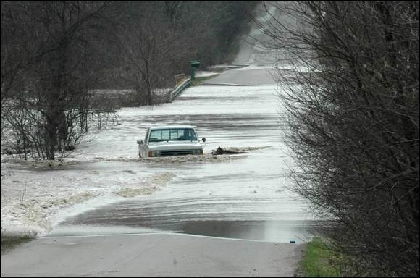
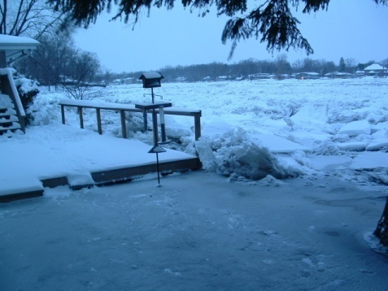
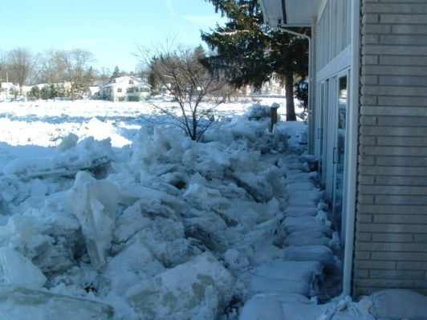
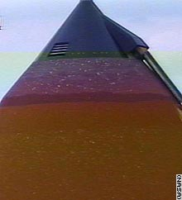
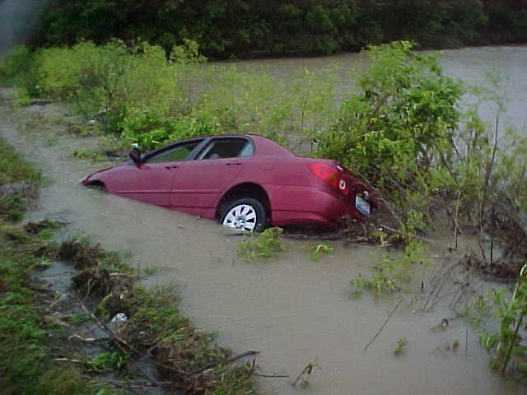
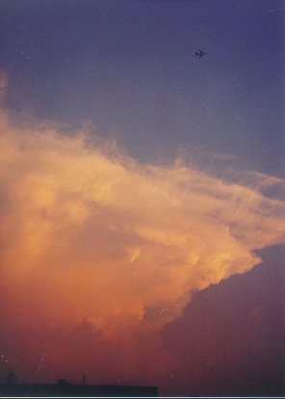
Who uses CoCoRaHS data?
National Weather Service
NASA
Private sector meteorologists
Hydrologists /climatologists
Emergency managers
City planners and utilities
Insurance adjusters
USDA
Engineers
Ranchers and farmers
Researchers and scientists
…and many others
Notes:
The CoCoRaHS data is finding many uses nationally. As more data is collected and more people find out about CoCoRaHS, this list will grow. NASA currently has a network of CoCoRaHS hail pads near the Kennedy Space Center launch pad to document their hail storms. A couple of their pads where dented badly in a late February thunderstorm, which also caused significant hail damage to the space shuttle Atlantis. NASA will be able to study data collected directly from the CoCoRaHS hail pads. Lets look at other possible applications of CoCoRaHS data.

Slide 20
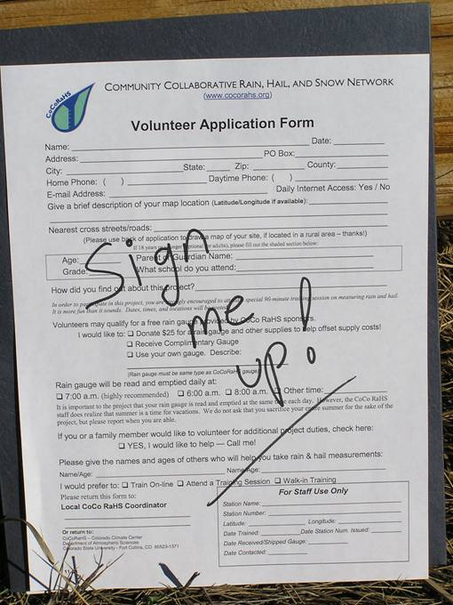
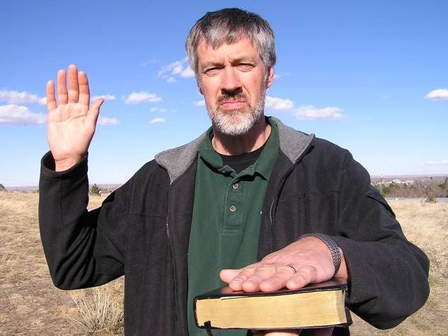
Joining CoCoRaHS
Things we need from you:
Completed application form
A commitment of at least one year
A sincere desire to help study and
and learn about storms
THAT’S IT!

Slide 21
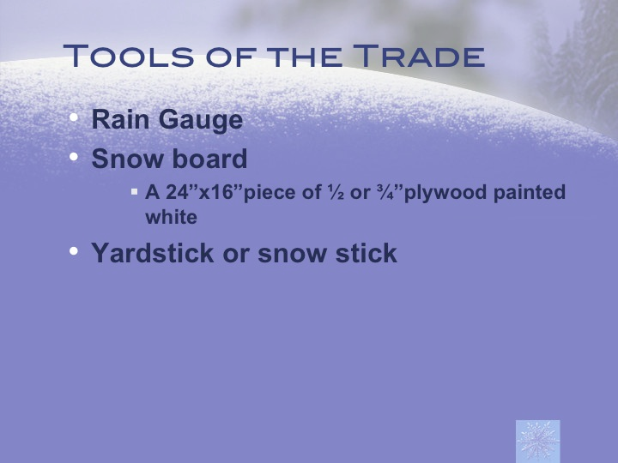

Slide 22


Slide 23


Slide 24


Slide 25


Slide 26


Slide 27


Slide 28


Slide 29


Slide 30


Slide 31


Slide 32


Slide 33


Slide 34


Slide 35


Slide 36


Slide 37


Slide 38


Slide 39


Slide 40


Slide 41


Slide 42


Slide 43


Slide 44


Slide 45


Slide 46


Slide 47


Slide 48


Slide 49


Slide 50


Slide 51


Slide 52


Slide 53


Slide 54


Slide 55


Slide 56


Slide 57


Slide 58


Slide 59


Slide 60


Slide 61


Slide 62


Slide 63


Slide 64


Slide 65


Slide 66


Come Join Us!
All you need is:
- a standard 4-inch rain gage (available on cocorahs.org for
around $25)
- an internet connection
- a maximum of 5 minutes per day
Sign up at http://www.cocorahs.org
Simply by sitting through our presentation here, you are fully qualified to join the CoCoRaHS program. Review the liquid precipitation slide show on the CoCoRaHS site.
We welcome your participation
and look forward to your reports!

Slide 67


Slide 68

Thanks for attending!
Questions, comments, or concerns?
CoCoRaHS Contacts:
George.wetzel@noaa.gov
Jamie.bielinski@noaa.gov

Slide 69
Optional snow core info
www.cocorahs.org

Slide 70


Slide 71


Slide 72


Slide 73


Slide 74


Slide 75


Slide 76


Slide 77


